Slide 1
Stock Price prediction using Big Data Visualization Technique
Priyanka Vyas, Nibedita Roy,
pvyas2@kent.edu , nroy2@kent.edu
Department of Computer Science
Kent State University
Notes:
Motivation
As there are no significant rules or methods to estimate the price of a share in the share market, the stock market is an ambiguous arena for predicting future prices. As a result, the main objective of this project is to translate information into a visual context in order to make it simpler for the human brain to absorb and assist a user in making a decision.

Slide 2
Finalize the component for preprocessing the data and importing them into the framework
Develop the LSTM algorithm and experiment on the dataset
Referred section II-B and II-C of sample paper for ideation and report
Milestone 2

Slide 3
Prediction Model Approach
Tableau (Problem statement visualization
Milestone 2
Sequential Learning
Attribute: Close Price
No. of layers: 4
Window size nstep: 100
Loss Function:MSE
Optimizer: Adam
Epochs: 20
Batch size:64
Parameters: 50851
LSTM
Training Set
Historical Data (10)yr
Price Prediction based on ‘Close’ Stock price data
Visualization using Matplotlib
Test Set
Milestone 1
Milestone 4
Model Evaluation (Performance test)
using Mean Square Error ( MSE)
Tableau (Performance Visualization)
Milestone 3

Slide 4
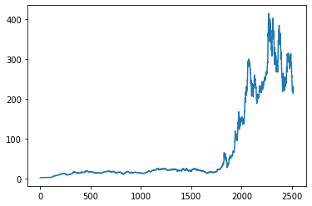
Loaded the data
Historical 10 year data
Close value graph using pyplot
Scale and reshape the data
Train and Test Split
Training data size=65% of total length of data frame and Test data size=35%
Data Preprocessing
Incorporate Time steps into data
Use numpy to create it into array
Milestone 2: Data-Preprocessing
Notes:
In time series data one data is dependent on other data.

Slide 5
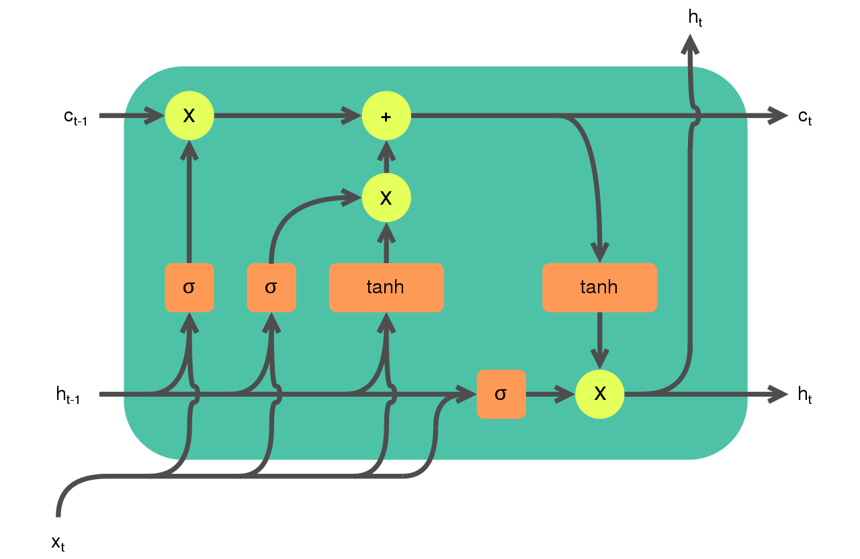
Improved version of Recurrent neural network
Remember information over long period of time
Model suitable for Stock price prediction.
Three gates: Input gate, Forget gate and Output gate
Tanh activation function squishes values between -1 and 1
About LSTM network
Notes:
Long Short-Term Memory (or) LSTMs are widely used for sequence prediction problems and have proven to be extremely effective. The reason they work so well is because LSTM is able to store past information that is important and forget the information that is not. LSTM has three types of gates:
1. The input gate: The input gate adds information to the cell state.
2. The forget gate: It removes the information that is no longer required by the model.
3. The output gate: Output Gate at LSTM selects the information to be shown as output.

Slide 6
Algorithm Flow: Milestone 2
Download the stock price dataset: yfinance
Load .csv file as dataframe using Pandas
Plot Close values using .pyplot
Import the libraries
Build model using Tensorflow keras and preprocessed data using scikit-learn
Normalize or rescale data using Minmax scaler and reshape it
Rescale values between -1 and 1
For total Sample size
Split the dataset into Training and Test set size
Define window size ‘n_step’ of data in each training step
X is n_step less than original dataset
Notes:
The objective of the proposed work is to study and improve the supervised learning algorithms to predict the stock price.

Slide 7
Min max scaler to transform values from 0 to 1
Fit.transform to reshape the values
Create data in n_step i.e. window size
Use numpy to convert data into array
Convert data into 3D array with X train sample, time_step and one feature
Proposed Milestone 3 plan:
Sequential model with LSTM layers to fit train-test set
Compile model using loss function and optimizer
Fit and run model for epoch and batch size.
Training metrics and function
https://colab.research.google.com/drive/1h7aR1UkmnYbUyU9ECBlIh61V-6Gxoplg?usp=sharing
Notes:
Input the data in the form of a 3D array to the LSTM model. First, we create data in 100 timesteps before using numpy to convert it into an array. Finally, convert the data into a 3D array with X_train samples, 100 timestamps, and one feature at each step

Slide 8
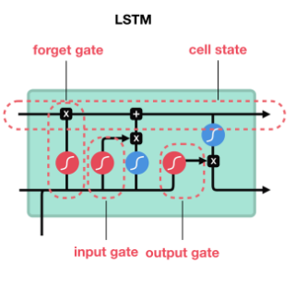
RNN suffers from short-term memory.
Vanishing gradient problem during back propagation.
Gradients are values used to update NN weight.
Layers that get small gradient update stops learning
Tanh function squishes values to always be between -1 and 1.
LSTM- Information gets added or removed to the cell state via gates
Gates, regulate information flow.
Forget,Input and Output gate.
LSTM v/s RNN
Notes:
During back propagation, recurrent neural networks suffer from the vanishing gradient problem. Gradients are values used to update a neural networks weights. The vanishing gradient problem is when the gradient shrinks as it back propagates through time. If a gradient value becomes extremely small, it doesn’t contribute too much learning.

Slide 9
Data is not normalized and range for each column varies
Small batch size reduce the speed of training
Normalizing data helps algorithm in converging i.e local/global minimum efficiently
LSTM consumes input in [batch_size, time_steps, Features] i.e. a 3D array
Data Visualization tool Tableau used to visualize problem statement (Milestone 1) and model result (Milestone 4)
Conclusion
Notes:
The technical objectives is implemented in Python. The system is able to access a list of historical prices.
It must calculate the estimated price of stock based on the historical data for the next 30 days. It must also provide an instantaneous visualization of the market index in a neatly formatted Python-Based Web App.

Slide 10
Thank You

